Slide 1
C Programming
Padma T G
Department of CSE,ACET

Slide 2
History and Importance of C Programming
Origin of C Language:
Developed in the early 1970s by Dennis Ritchie at Bell Labs.
Created to write the UNIX operating system.
Foundation for Modern Languages:
C is the "mother" of many modern languages like C++, Java, and C#.
Learning C provides a strong foundation for understanding these languages.

Slide 3
Advantages and Disadvantages of C
Advantages:
Portability: Easily transferred across machines.
Efficiency: Ideal for system software.
Versatility: Used in OS development, embedded systems, game development, etc.
Disadvantages:
C does not provide built-in support for concurrency, making it more difficult to write multithreaded applications compared to languages like Java or Go.
Lack of memory management and object-oriented programming support.
Security vulnerabilities.

Slide 4
Real-World Applications of C
Operating Systems: Unix, Linux, Windows.
Embedded Systems: Microcontrollers, microprocessors.
System Software: Device drivers, compilers, assemblers.
Others: Networking applications, database systems, gaming, AI, and scientific applications.

Slide 5
Google
Microsoft
Apple
Amazon
NVIDIA
Qualcomm
Intel
Electronic Arts
Ubisoft
Epic Games
"Aim for the moon. If you miss, you may hit a star."

Slide 6
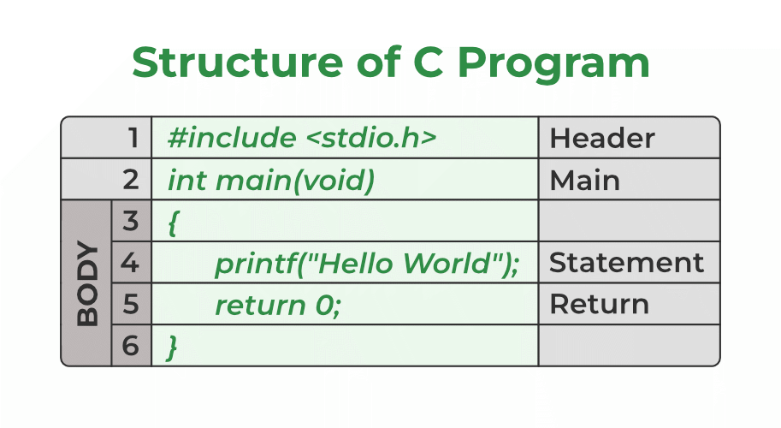
Structure of a C Program
Components of a C Program:
Header Files Inclusion: #include <stdio.h>
Main Method Declaration: int main()
Body of Main Method: Code within { }
Statements: Instructions like printf()
Return Statement: return 0;

Slide 7
Example
#include <stdio.h>
int main() {
int a = 10;
printf("%d", a);
return 0;
}
Output: 10

Slide 8
A header file is a file with extension .h which contains C function declarations and macro definitions to be shared between several source files.
All lines that start with # are processed by a preprocessor which is a program invoked by the compiler.
In the above example, the preprocessor copies the preprocessed code of stdio.h to our file. The .h files are called header files in C.
Some of the C Header files:
• stddef.h – Defines several useful types and macros.
• stdint.h – Defines exact width integer types.
• stdio.h – Defines core input and output functions
• stdlib.h – Defines numeric conversion functions, pseudo-random number generator, and memory allocation
• string.h – Defines string handling functions
• math.h – Defines common mathematical functions.

Slide 9
Compilation Process
Four Phases:
Pre-processing: Removal of comments, expansion of macros, Expansion of the included files. The preprocessed output is stored in the filename.i.
Compilation: The next step is to compile filename.i and produce an intermediate compiled output file filename.s. This file is in assembly-level instructions.
Assembly: Conversion to machine-level instructions. In this phase the filename.s is taken as input and turned into filename.o by the assembler.
Linking: Linking function calls with their definitions. Linker knows where all these functions are implemented. Linker does some extra work also, it adds some extra code to our program which is required when the program starts and ends.
GCC by default does dynamic linking, so printf() is dynamically linked in above program.

Slide 10
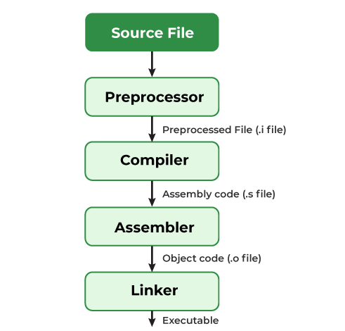

Slide 11
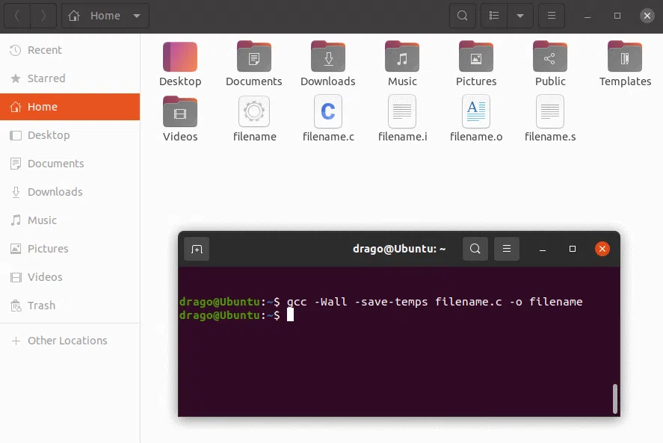
How to Execute a C Program
Windows: Use IDEs like Code Blocks or Dev-CPP.
Linux: Use GCC compiler or IDEs like Code Blocks.
macOS: Use the built-in text editor.

Slide 12
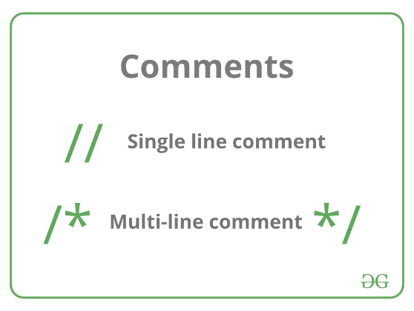
Comments in C
Types of Comments:
Single-line comment: // comment
Multi-line comment: /* comment */

Slide 13
Tokens in C
A token in C can be defined as the smallest individual element of the C programming language that is meaningful to the compiler.
It is the basic component of a C program.
Types of Tokens:
Keywords: Reserved words like int, return.
Identifiers: Names for variables, functions.
Constants: Fixed values like const int c = 20;
Literals: Fixed values assigned to variables.
Operators: Symbols triggering actions like +, -.
Special Symbols

Slide 14
#include <stdio.h>
int main() {
int a = 10;
Int b, c;
b= 20;
c=a+b
printf("%d", c);
printf("%d", a);
return 0;
}
Output: 30
10

Slide 15
1. Keywords
Are pre-defined or reserved words in a programming language. Each keyword is meant to perform a specific function in a program.
Since keywords are referred names for a compiler, they can’t be used as variable names because by doing so, we are trying to assign a new meaning to the keyword which is not allowed.
You cannot redefine keywords. However, you can specify the text to be substituted for keywords before compilation by using C preprocessor directives.
C language supports 32 keywords which are given below:

Slide 16
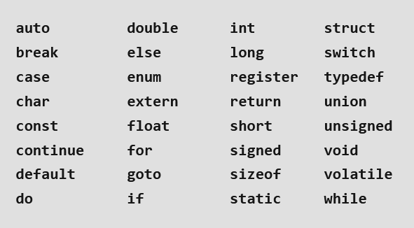
The number of keywords may change depending on the version of C you are using. For example, keywords present in ANSI C are 32 while in C11, it was increased to 44. Moreover, in the latest c23, it is increased to around 54.
Current version is C17. Published in June 2018

Slide 17
2. Identifiers:
Identifiers are used as the general terminology for the naming of variables, functions, and arrays.
These are user-defined names.
Rules for Naming Identifiers
Certain rules should be followed while naming c identifiers which are as follows:
They must begin with a letter or underscore (_).
They must consist of only letters, digits, or underscore. No other special character is allowed.
It should not be a keyword.
It must not contain white space.
It should be up to 31 characters long as only the first 31 characters are significant.
Identifiers are case-sensitive so names like variable and Variable will be treated as different.

Slide 18
age: Contains only letters.
_total: Starts with an underscore.
sum_of_marks: Contains letters and underscores.
Max123: Starts with a letter and includes digits.
count2: Starts with a letter and includes digits.
2count: Starts with a digit, which is not allowed.
total#marks: Contains a special character (#), which is not allowed.
int: This is a reserved keyword in C, so it cannot be used as an identifier.
total marks: Contains a space, which is not allowed.
float!rate: Contains a special character (!), which is not allowed.

Slide 19
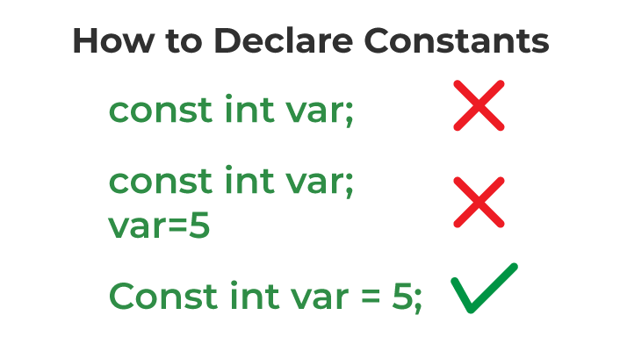
3. Constants
The constants refer to the variables with fixed values. They are like normal variables but with the difference that their values can not be modified in the program once they are defined.
Constants may belong to any of the data types.
One thing to note here is that we have to initialize the constant variables at declaration. Otherwise, the variable will store some garbage value and we won’t be able to change it.
const data_type var_name = value;
const int c_var = 20;
const int* const ptr = &c_var;

Slide 20
Types of Constants in C
The type of the constant is the same as the data type of the variables. Following is the list of the types of constants
Integer Constant
Character Constant
Floating Point Constant
Double Precision Floating Point Constant
Array Constant
Structure Constant

Slide 21
int main()
{
// defining integer constant using const keyword
const int int_const = 25;
// defining character constant using const keyword
const char char_const = 'A';
// defining float constant using const keyword
const float float_const = 15.66;
printf("Printing value of Integer Constant: %d\n",
int_const);
printf("Printing value of Character Constant: %c\n",
char_const);
printf("Printing value of Float Constant: %f",
float_const);
return 0;
}
Output:
Printing value of Integer Constant: 25
Printing value of Character Constant: A
Printing value of Float Constant: 15.660000

Slide 22
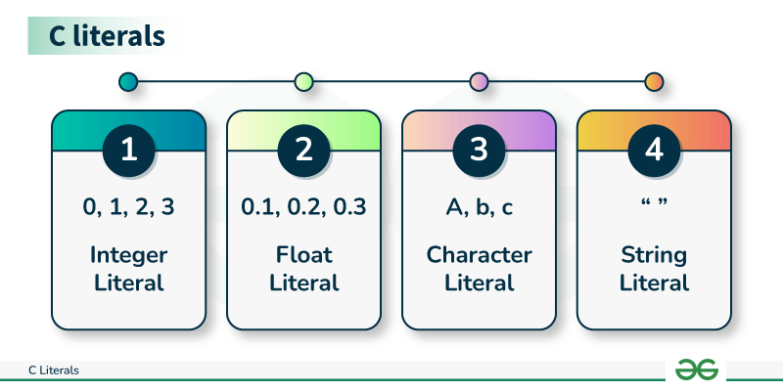
Literals in C
Literals are the constant values that are assigned to the variables. Literals represent fixed values that cannot be modified. Literals contain memory but they do not have references as variables. Generally, both terms, constants, and literals are used interchangeably.
For example, “const int = 5;“, is a constant expression and the value 5 is referred to as a constant integer literal.

Slide 23
Types of C Literals
There are 4 types of literal in C:
Integer Literal
const int = 5
Float Literal
const float floatVal = 4.14;
Character Literal
char chr = 'G';
String Literal
char stringVal[] = "LearnC";

Slide 24
Constant | Literals
Constants are variables that cannot be modified once declared. | Literals are the fixed values that define themselves.
Constants are defined by using the const keyword in C. They store literal values in themselves. | They themselves are the values that are assigned to the variables or constants.
We can determine the address of constants. | We cannot determine the address of a literal except string literal.
Example: const int c = 20. | Example: 24,15.5, ‘a’, etc.

Slide 25
4. Strings
Strings are nothing but an array of characters ended with a null character (‘\0’). This null character indicates the end of the string. Strings are always enclosed in double quotes. Whereas, a character is enclosed in single quotes in C and C++.
char string[20] = {‘g’, ’e’, ‘e’, ‘k’, ‘s’, ‘f’, ‘o’, ‘r’, ‘g’, ’e’, ‘e’, ‘k’, ‘s’, ‘\0’};
char string[20] = “LearnC”;
char string [] = “LearnC”;

Slide 26
5. Special Symbols
The following special symbols are used in C having some special meaning and thus, cannot be used for some other purpose. Some of these are listed below:
Brackets[]: Opening and closing brackets are used as array element references. These indicate single and multidimensional subscripts.
Parentheses(): These special symbols are used to indicate function calls and function parameters.
Braces{}: These opening and ending curly braces mark the start and end of a block of code containing more than one executable statement.
Comma (, ): It is used to separate more than one statement like for separating parameters in function calls.
Colon(:): It is an operator that essentially invokes something called an initialization list.

Slide 27
Semicolon(;): It is known as a statement terminator. It indicates the end of one logical entity. That’s why each individual statement must be ended with a semicolon.
Asterisk (*): It is used to create a pointer variable and for the multiplication of variables.
Assignment operator(=): It is used to assign values and for logical operation validation.
Pre-processor (#): The preprocessor is a macro processor that is used automatically by the compiler to transform your program before actual compilation.
Period (.): Used to access members of a structure or union.
Tilde(~): Bitwise One’s Complement Operator.

Slide 28
6. Operators
Operators are symbols that trigger an action when applied to C variables and other objects. The data items on which operators act are called operands.
Depending on the number of operands that an operator can act upon, operators can be classified as follows:
Unary Operators: Those operators that require only a single operand to act upon are known as unary operators.
For Example increment and decrement operators, i++, i--.
Ternary Operator: The operator that requires three operands to act upon is called the ternary operator. Conditional Operator(?) is also called the ternary operator.
Binary Operators: Those operators that require two operands to act upon are called binary operators. Binary operators can further are classified into:
  Arithmetic operators
  Relational Operators
  Logical Operators
  Assignment Operators
  Bitwise Operator

Slide 29
C Variables
A variable in C is a memory location with some name that helps store some form of data and retrieves it when required. We can store different types of data in the variable and reuse the same variable for storing some other data any number of times.
C is a strongly typed language so all the variables types must be specified before using them.
C Variable Syntax
data_type variable_name = value; // defining single variable
or
data_type variable_name1, variable_name2; // defining multiple variable
Example
int var; // integer variable
char a; // character variable
float fff; // float variables

Slide 30
3 aspects of defining a variable:
Variable Declaration: Variable declaration in C tells the compiler about the existence of the variable with the given name and data type. When the variable is declared, an entry in symbol table is created and memory will be allocated at the time of initialization of the variable.
Variable Definition: In the definition of a C variable, the compiler allocates some memory and some value to it. A defined variable will contain some random garbage value till it is not initialized.
int var;
char var2;
Variable Initialization: Initialization of a variable is the process where the user assigns some meaningful value to the variable when creating the variable.
int var = 10; // variable declaration and definition (i.e. Vairable Initialization)

Slide 31
Difference between Variable Initialization and Assignment
Initialization occurs when a variable is first declared and assigned an initial value. This usually happens during the declaration of the variable. On the other hand, assignment involves setting or updating the value of an already declared variable, and this can happen multiple times after the initial initialization.
int a=10; //Variable initialization
a=10; //assignment
Rules for Naming Variables in C
You can assign any name to the variable as long as it follows the following rules:
A variable name must only contain alphabets, digits, and underscore.
A variable name must start with an alphabet or an underscore only. It cannot start with a digit.
No white space is allowed within the variable name.
A variable name must not be any reserved word or keyword.

Slide 32
// C program to demonstrate the
// declaration, definition and
// initialization
#include <stdio.h>
int main()
{
// declaration with definition
int defined_var;
printf("Defined_var: %d\n", defined_var);
// assignment
defined_var = 12;
// declaration + definition + initialization
int ini_var = 25;
printf("Value of defined_var after assignment: %d\n", defined_var);
printf("Value of ini_var: %d", ini_var);
return 0;
}
Defined_var: 0
Value of defined_var after assignment: 12
Value of ini_var: 25

Slide 33
C Variable Types
The C variables can be classified into the following types:
Local Variables and Global Variables
// C program to demonstrate use of global variable
#include <stdio.h>
int x = 20; // global variable
void function1() {
int x = 30;
printf("Function 1: %d\n", x);
printf("Function 1: %d\n", x);
}
void function2() { printf("Function 2: %d\n", x); }
int main()
{
printf("Function 1: %d\n", x);
function1();
function2();
return 0;
}
Output:
Function 1: 20
Function 1: 30
Function 1: 30
Function 2: 20

Slide 34
Static Variables is a variable that is defined using the static keyword. It can be defined only once in a C program and its scope depends upon the region where it is declared (can be global or local). The default value of static variables is zero.
static data_type variable_name = initial_value;
// C program to demonstrate use of static variable
#include <stdio.h>
void function()
{
int x = 20; // local variable
static int y = 30; // static variable
x = x + 10;
y = y + 10;
printf("\tLocal: %d\n\tStatic: %d\n", x, y);
}
int main()
{
printf("First Call\n");
function();
printf("Second Call\n");
function();
printf("Third Call\n");
function();
return 0;
}
Output:
First Call
Local: 30
Static: 40
Second Call
Local: 30
Static: 50
Third Call
Local: 30
Static: 60
In the above example, we can see that the local variable will always print the same value whenever the function will be called whereas the static variable will print the incremented value in each function call.

Slide 35
Automatic Variables
All the local variables are automatic variables by default. They are also known as auto variables. Their scope is local and their lifetime is till the end of the block. If we need, we can use the auto keyword to define the auto variables. The default value of the auto variables is a garbage value.
auto data_type variable_name;
or
data_type variable name; (in local scope)
Extern Variables : External variables in C can be shared between multiple C files. We can declare an external variable using the extern keyword.
Their scope is global and they exist between multiple C files.
Register Variables
Register variables in C are those variables that are stored in the CPU register instead of the conventional storage place like RAM. Their scope is local and exists till the end of the block or a function. These variables are declared using the register keyword. The default value of register variables is a garbage value.
register data_type variable_name = initial_value;

Slide 36
Scope rules in C
The scope of a variable in C is the block or the region in the program where a variable is declared, defined, and used. Outside this region, we cannot access the variable and it is treated as an undeclared identifier.
Types of Scope Rules in C
C scope rules can be covered under the following two categories:
Global Scope
The global scope refers to the region outside any block or function.
The variables declared in the global scope are called global variables.
Global variables are visible in every part of the program.
Global is also called File Scope as the scope of an identifier starts at the beginning of the file and ends at the end of the file.

Slide 37
Local Scope
The local scope refers to the region inside a block or a function. It is the space enclosed between the { } braces.
The variables declared within the local scope are called local variables.
Local variables are visible in the block they are declared in and other blocks nested inside that block.
Local scope is also called Block scope.
Local variables have internal linkage.

Slide 38
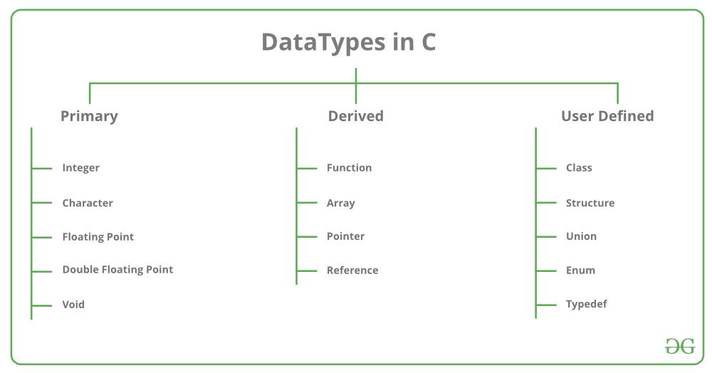
Data Types in C
Types | Description
Primitive Data Types | Primitive data types are the most basic data types that are used for representing simple values such as integers, float, characters, etc.
User Defined Data Types | The user-defined data types are defined by the user himself.
Derived Types | The data types that are derived from the primitive or built-in datatypes are referred to as Derived Data Types.

Slide 39
Integer Data Type
The integer datatype in C is used to store the integer numbers(any number including positive, negative and zero without decimal part). Octal values, hexadecimal values, and decimal values can be stored in int data type in C.
int var_name;
The integer data type can also be used as
unsigned int: Unsigned int data type in C is used to store the data values from zero to positive numbers but it can’t store negative values like signed int.
short int: It is lesser in size than the int by 2 bytes so can only store values from -32,768 to 32,767.
long int: Larger version of the int datatype so can store values greater than int.
unsigned short int: Similar in relationship with short int as unsigned int with int.

Slide 40
// C program to print Integer data types.
#include <stdio.h>
int main()
{
// Integer value with positive data.
int a = 9;
// integer value with negative data.
int b = -9;
// U or u is Used for Unsigned int in C.
int c = 89U;
// L or l is used for long int in C.
long int d = 99998L;
printf("Integer value with positive data: %d\n", a);
printf("Integer value with negative data: %d\n", b);
printf("Integer value with an unsigned int data: %u\n",
c);
printf("Integer value with an long int data: %ld", d);
return 0;
}
Integer value with positive data: 9
Integer value with negative data: -9
Integer value with an unsigned int data: 89
Integer value with an long int data: 99998

Slide 41
Character Data Type
Character data type allows its variable to store only a single character. The size of the character is 1 byte. It is the most basic data type in C. It stores a single character and requires a single byte of memory in almost all compilers.
Range: (-128 to 127) or (0 to 255)
Size: 1 byte
Format Specifier: %c
char var_name;

Slide 42
// c is assigned ASCII values
// which corresponds to the
// character 'c'
// a-->97 b-->98 c-->99
// here c will be printed
c = 99;
printf("Value of c: %c", c);
return 0;
}
Output:
Value of a: a
Value of a after increment is: b
Value of c: c
// C program to print Integer data types.
#include <stdio.h>
int main()
{
char a = 'a';
char c;
printf("Value of a: %c\n", a);
a++;
printf("Value of a after increment is: %c\n", a);

Slide 43
Float Data Type
Float Data Type is used to store floating-point values. Float in C is used to store decimal and exponential values. It is used to store decimal numbers (numbers with floating point values) with single precision.
Range: 1.2E-38 to 3.4E+38
Size: 4 bytes
Format Specifier: %f
float var_name;

Slide 44
// C Program to demonstrate use
// of Floating types
#include <stdio.h>
int main()
{
float a = 9.0f;
float b = 2.5f;
// 2x10^-4
float c = 2E-4f;
printf("%f\n", a);
printf("%f\n", b);
printf("%f", c);
return 0;
}
9.000000
2.500000
0.000200

Slide 45
Double Data Type
Double Data Type :is used to store decimal numbers (numbers with floating point values) with double precision. It is used to define numeric values which hold numbers with decimal values in C.
Range: 1.7E-308 to 1.7E+308
Size: 8 bytes
Format Specifier: %lf
double var_name;

Slide 46
// C Program to demonstrate
// use of double data type
#include <stdio.h>
int main()
{
double a = 123123123.00;
double b = 12.293123;
double c = 2312312312.123123;
printf("%lf\n", a);
printf("%lf\n", b);
printf("%lf", c);
return 0;
}
123123123.000000
12.293123
2312312312.123123

Slide 47
Void Data Type
Void Data Type :
The void data type in C is used to specify that no value is present. It does not provide a result value to its caller. It has no values and no operations. It is used to represent nothing. Void is used in multiple ways as function return type, function arguments as void, and pointers to void.

Slide 48
Size of Data Types in C
The size of the data types in C is dependent on the size of the architecture, so we cannot define the universal size of the data types. For that, the C language provides the sizeof() operator to check the size of the data types.
// C Program to print size of
// different data type in C
#include <stdio.h>
int main()
{
int size_of_int = sizeof(int);
int size_of_char = sizeof(char);
int size_of_float = sizeof(float);
int size_of_double = sizeof(double);

Slide 49
printf("The size of int data type : %d\n", size_of_int);
printf("The size of char data type : %d\n",
size_of_char);
printf("The size of float data type : %d\n",
size_of_float);
printf("The size of double data type : %d",
size_of_double);
return 0;
}
Output:
The size of int data type : 4
The size of char data type : 1
The size of float data type : 4
The size of double data type : 8

Slide 50
Type Conversion in C
Type conversion in C is the process of converting one data type to another. The type conversion is only performed to those data types where conversion is possible. Type conversion is performed by a compiler.
In type conversion, the destination data type can’t be smaller than the source data type.
Type conversion is done at compile time and it is also called widening conversion because the destination data type can’t be smaller than the source data type.
There are two types of Conversion:
Implicit Type Conversion
Also known as ‘automatic type conversion’.
Done by the compiler on its own, without any external trigger from the user.
Generally takes place when in an expression more than one data type is present. In such conditions type conversion (type promotion) takes place to avoid loss of data.
All the data types of the variables are upgraded to the data type of the variable with the largest data type.

Slide 51
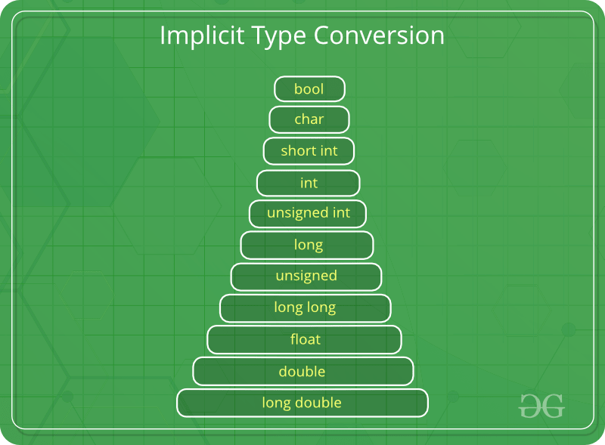

Slide 52
// An example of implicit conversion
#include <stdio.h>
int main()
{
int x = 10; // integer x
char y = 'a'; // character c
// y implicitly converted to int. ASCII
// value of 'a' is 97
x = x + y;
// x is implicitly converted to float
float z = x + 1.0;
printf("x = %d, z = %f", x, z);
return 0;
}
x = 107, z = 108.000000

Slide 53
Explicit Type Conversion
This process is also called type casting and it is user-defined. Here the user can typecast the result to make it of a particular data type.
The syntax in C Programming:
(type) expression
// C program to demonstrate explicit type casting #include<stdio.h>
int main()
{
double x = 1.2;
// Explicit conversion from double to int
int sum = (int)x + 1;
printf("sum = %d", sum);
return 0;
}
sum = 2

Slide 54
Basic Input and Output in C
C language has standard libraries that allow input and output in a program. The stdio.h or standard input output library in C that has methods for input and output.
scanf()
The scanf() method, in C, reads the value from the console as per the type specified and store it in the given address.
scanf("%X", &variableOfXType);
printf()
The printf() method, in C, prints the value passed as the parameter to it, on the console screen.
printf("%X", variableOfXType);

Slide 55
Integer
Input: scanf("%d", &intVariable);
Output: printf("%d", intVariable);
Float
Input: scanf("%f", &floatVariable);
Output: printf("%f", floatVariable);
Character
Input: scanf("%c", &charVariable);
Output: printf("%c", charVariable);
String
Input: scanf("%s", stringVariable);
Output: printf("%s", stringVariable);

Slide 56
Formatted and Unformatted Input/Output functions
Formatted I/O Functions.
The following formatted I/O functions will be discussed in this section-
printf()
scanf()
Unformatted I/O Functions.
Unformatted I/O functions are used only for character data type or character array/string and cannot be used for any other datatype. These functions are used to read single input from the user at the console and it allows to display the value at the console.

Slide 57
The following unformatted I/O functions will be discussed in this section-
getch()
getche()
getchar()
putchar()
// C program to implement
// the putchar() and getchar() function
#include <conio.h>
#include <stdio.h>
// Driver code
int main()
{
char ch;
printf("Enter any character: ");
// Reads a character
ch = getchar();
// Displays that character
putchar(ch);
return 0;
}

Slide 58
// C program to implement
// the puts() and gets() function
#include <stdio.h>
// Driver code
int main()
{
char name[50];
printf("Enter your text: ");
// Reads string from user
gets(name);
printf("Your text is: ");
// Displays string
puts(name);
return 0;
}

Slide 59
The conditional statements
The conditional statements (also known as decision control structures) such as if, if else, switch, etc. are used for decision-making purposes in C programs.
if Statement
if-else Statement
Nested if Statement
if-else-if Ladder
switch Statement
Conditional Operator
Jump Statements:
  break
  continue
  goto
  return

Slide 60
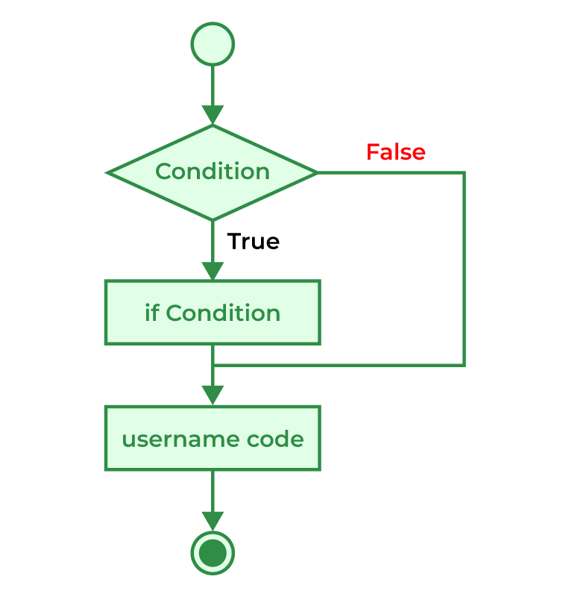
if in C
if(condition)
{
// Statements to execute if
// condition is true
}

Slide 61
// C program to illustrate If statement
#include <stdio.h>
int main()
{
int i = 10;
if (i > 15) {
printf("10 is greater than 15");
}
printf(“10 is smaller than 15");
}
Output
10 is smaller than 15

Slide 62
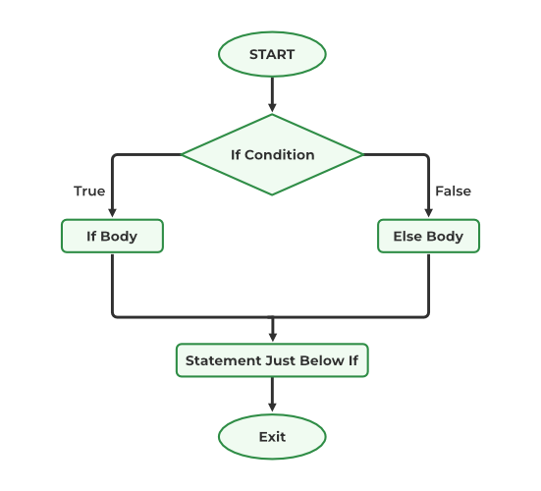
if-else in C
if (condition)
{
// Executes this block if
// condition is true
}
else
{
// Executes this block if
// condition is false
}

Slide 63
// C program to illustrate If statement
#include <stdio.h>
int main()
{
int i = 20;
if (i < 15) {
printf("i is smaller than 15");
}
else {
printf("i is greater than 15");
}
return 0;
}
Output:
i is greater than 15

Slide 64
Nested if-else in C
if (condition1)
{
// Executes when condition1 is true
if (condition_2)
{
// statement 1
}
else
{
// Statement 2
}
}
else {
if (condition_3)
{
// statement 3
}
else
{
// Statement 4
}
}

Slide 65
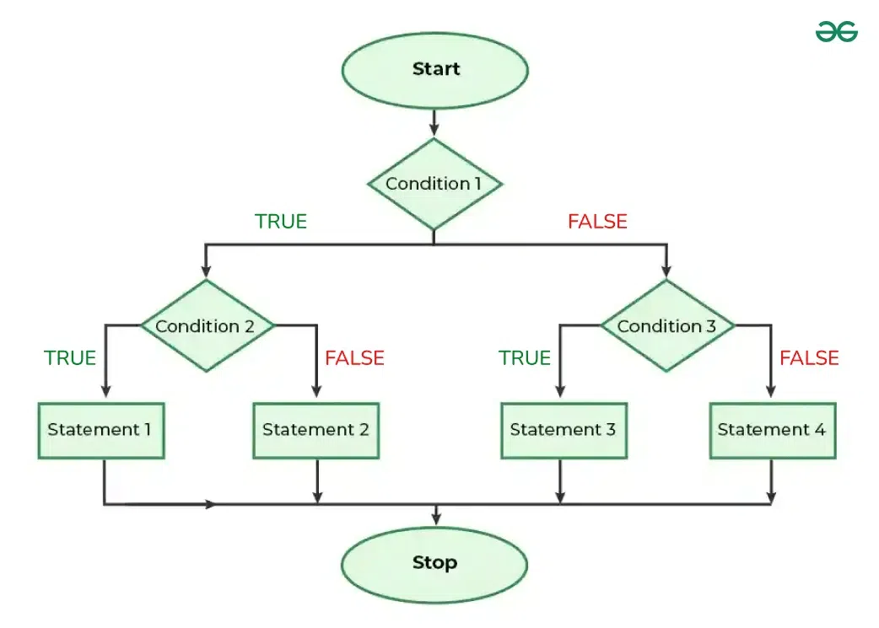

Slide 66
// C program to illustrate nested-if statement
#include <stdio.h>
int main()
{
int i = 10;
if (i == 10) {
// First if statement
if (i < 15)
printf("i is smaller than 15\n");
// Nested - if statement
// Will only be executed if statement above
// is true
if (i < 12)
printf("i is smaller than 12 too\n");
else
printf("i is greater than 15");
}
else {
if (i == 20) {
// Nested - if statement
// Will only be executed if statement above
// is true
if (i < 22)
printf("i is smaller than 22 too\n");
else
printf("i is greater than 25");
}
}
return 0;
}
Output:
i is smaller than 15
i is smaller than 12 too

Slide 67
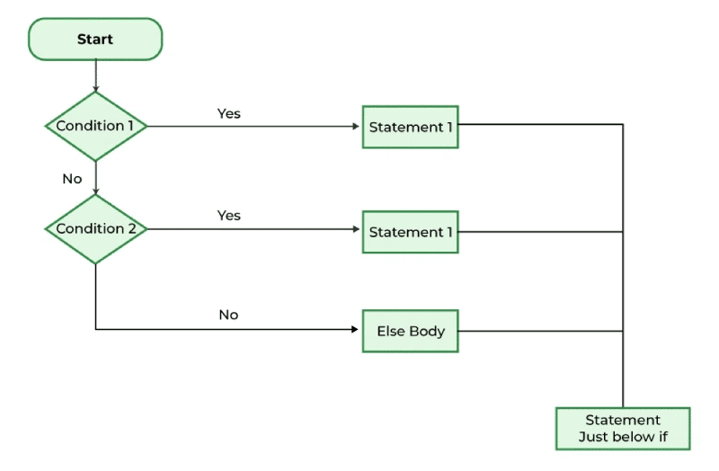
if-else-if Ladder in C
if (condition)
statement;
else if (condition)
statement;
.
.
else
statement;

Slide 68
// C program to illustrate nested-if statement
#include <stdio.h>
int main()
{
int i = 20;
if (i == 10)
printf("i is 10");
else if (i == 15)
printf("i is 15");
else if (i == 20)
printf("i is 20");
else
printf("i is not present");
}
output
i is 20

Slide 69
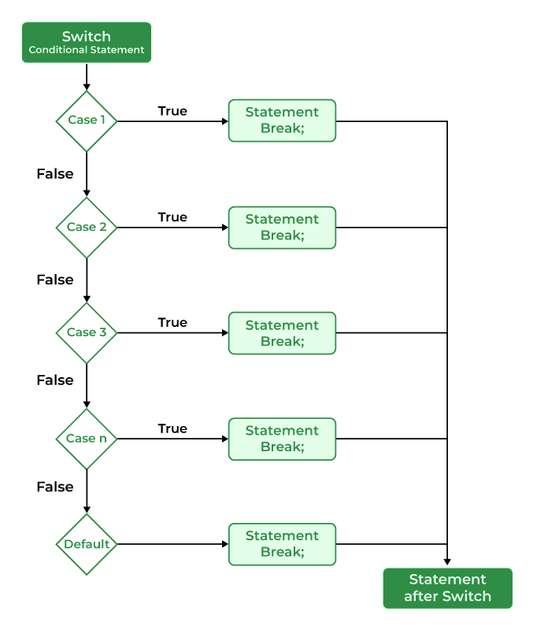
switch Statement in C
switch (expression) {
case value1:
statements;
case value2:
statements;
....
....
....
default:
statements;
}

Slide 70
// C Program to illustrate the use of switch statement
#include <stdio.h>
int main()
{
// variable to be used in switch statement
int var = 2;
// declaring switch cases
switch (var) {
case 1:
printf("Case 1 is executed");
break;
case 2:
printf("Case 2 is executed");
break;
default:
printf("Default Case is executed");
break;
}
return 0;
}
output
Case 2 is executed

Slide 71
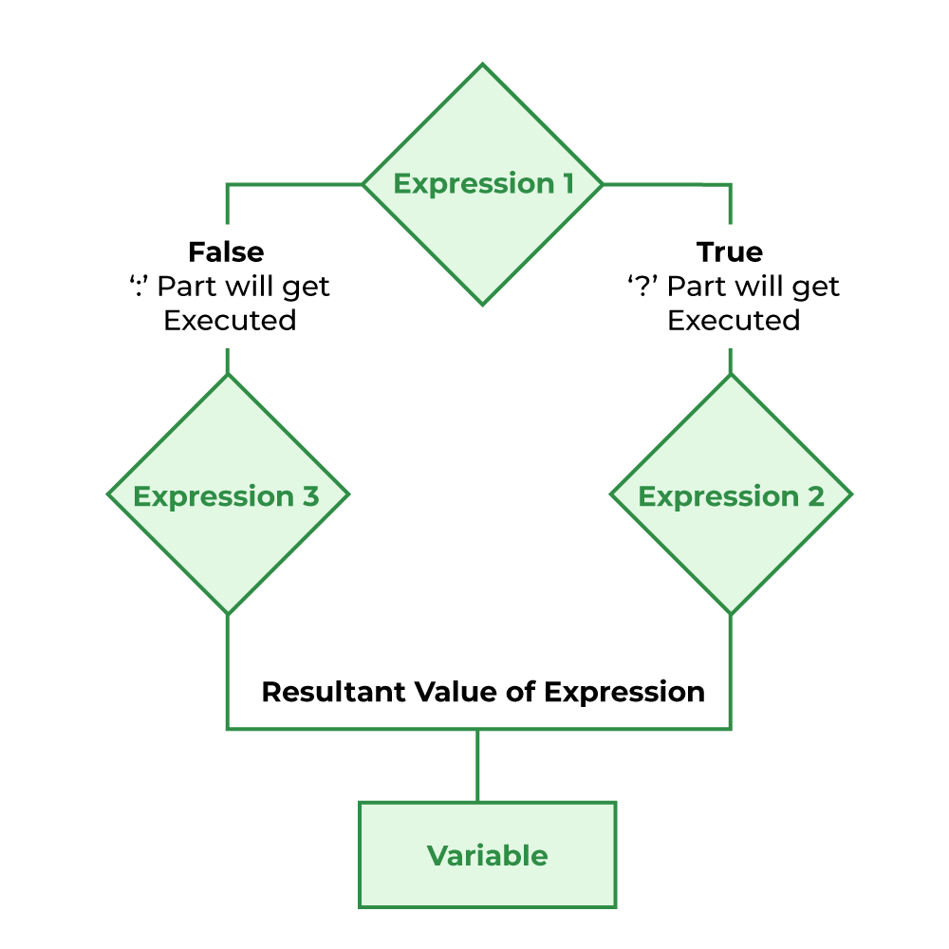
Conditional Operator in C
is used to add conditional code in our program.
It is similar to the if-else statement.
It is also known as the ternary operator as it works on three operands.
(condition) ? [true_statements] : [false_statements];

Slide 72
// C Program to illustrate the use of conditional operator
#include <stdio.h>
// driver code
int main()
{
int var;
int flag = 0;
// using conditional operator to assign the value to var
// according to the value of flag
var = flag == 0 ? 25 : -25;
printf("Value of var when flag is 0: %d\n", var);
// changing the value of flag
flag = 1;
// again assigning the value to var using same statement
var = flag == 0 ? 25 : -25;
printf("Value of var when flag is NOT 0: %d", var);
return 0;
}
Output:
Value of var when flag is 0: 25
Value of var when flag is NOT 0: -25

Slide 73
Jump Statements in C
The break statement is used to exit a loop or switch statement prematurely
#include <stdio.h>
int main() {
int i;
for(i = 1; i <= 10; i++) {
if(i == 5) {
break; // Exit the loop when i equals 5
}
printf("%d ", i);
}
printf("\nLoop exited at i = %d\n", i);
return 0;
}
Output:
1
2
3
4

Slide 74
continue Statement skips the current iteration of a loop and continues with the next iteration.
#include <stdio.h>
int main() {
int i;
for(i = 1; i <= 10; i++) {
if(i == 5) {
continue; // Skip the rest of the loop body when i equals 5
}
printf("%d ", i);
}
printf("\nLoop finished with continue statement\n");
return 0;
}

Slide 75
goto Statement transfers control to a labeled statement within the same function.
#include <stdio.h>
int main() {
int i = 1;
printf("Loop starts\n");
start_loop:
if(i <= 5) {
printf("%d ", i);
i++;
goto start_loop; // Go back to the start of the loop
}
printf("\nLoop ended with goto statement\n");
return 0;
}

Slide 76
return Statement is used to exit a function and optionally return a value to the calling function.
#include <stdio.h>
int square(int num) {
return num * num; // Return the square of the number
}
int main() {
int num = 5;
int result = square(num); // Call square function
printf("The square of %d is %d\n", num, result);
return 0; // Return 0 to indicate successful execution
}

Slide 77
C – Loops
Loops in programming are used to repeat a block of code until the specified condition is met. A loop statement allows programmers to execute a statement or group of statements multiple times without repetition of code.
for Loop in C
while loop in C
do…while Loop in C

Slide 78
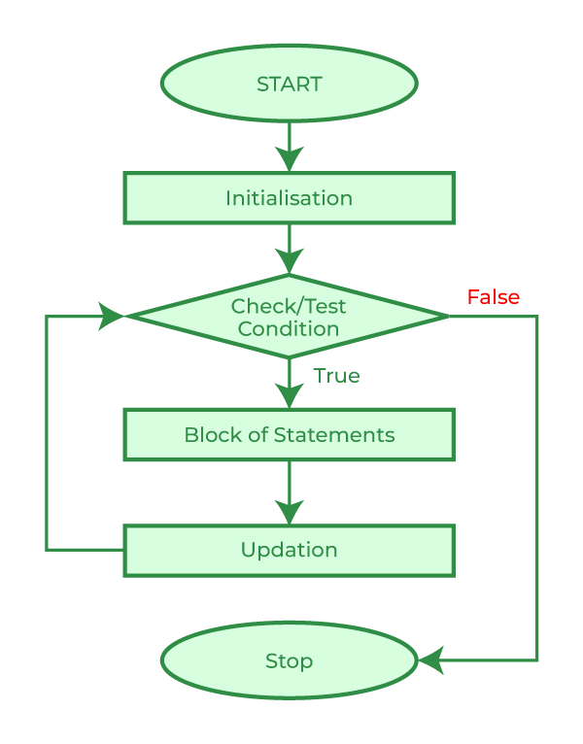
for Loop in C
The for loop is used when the number of iterations is known beforehand. It has three parts: initialization, condition, and increment/decrement.
for(initialization; condition; increment/decrement) {
// Loop body
}

Slide 79
#include <stdio.h>
int main() {
int i;
// Loop to print numbers from 1 to 5
for(i = 1; i <= 5; i++) {
printf("%d ", i);
}
return 0;
}
Output:
1 2 3 4 5

Slide 80
while loop in C
The while loop is used when the number of iterations is not known beforehand. The loop continues until the condition becomes false.
while(condition) {
// Loop body
}

Slide 81
#include <stdio.h>
int main() {
int i = 1;
// Loop to print numbers from 1 to 5
while(i <= 5) {
printf("%d ", i);
i++; // Increment the value of i
}
return 0;
}
Output:
1 2 3 4 5

Slide 82
do…while Loop in C
The do...while loop is similar to the while loop, but the loop body is executed at least once before the condition is tested.
do {
// Loop body
} while(condition);

Slide 83
#include <stdio.h>
int main() {
int i = 1;
// Loop to print numbers from 1 to 5
do {
printf("%d ", i);
i++; // Increment the value of i
} while(i <= 5);
return 0;
}
Output:
1 2 3 4 5

Slide 84
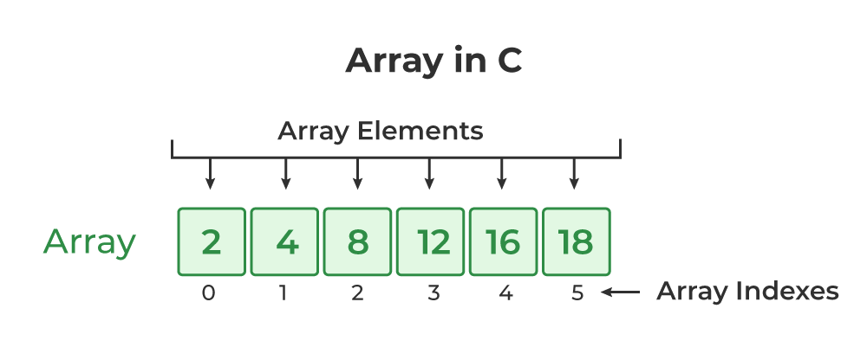
C Arrays
An array in C is a fixed-size collection of similar data items stored in contiguous memory locations. It can be used to store the collection of primitive data types such as int, char, float, etc., and also derived and user-defined data types such as pointers, structures, etc.

Slide 85
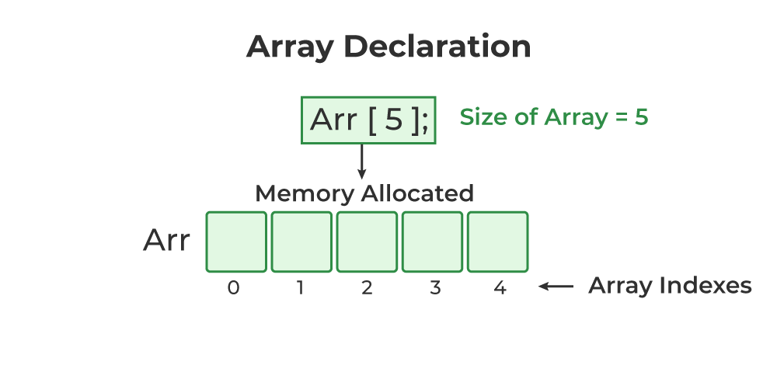
Syntax of Array Declaration
data_type array_name [size]; or
data_type array_name [size1] [size2]...[sizeN];
where N is the number of dimensions.
// C Program to illustrate the array declaration
#include <stdio.h>
int main()
{
// declaring array of integers
int arr_int[5];
// declaring array of characters
char arr_char[5];
return 0;
}

Slide 86
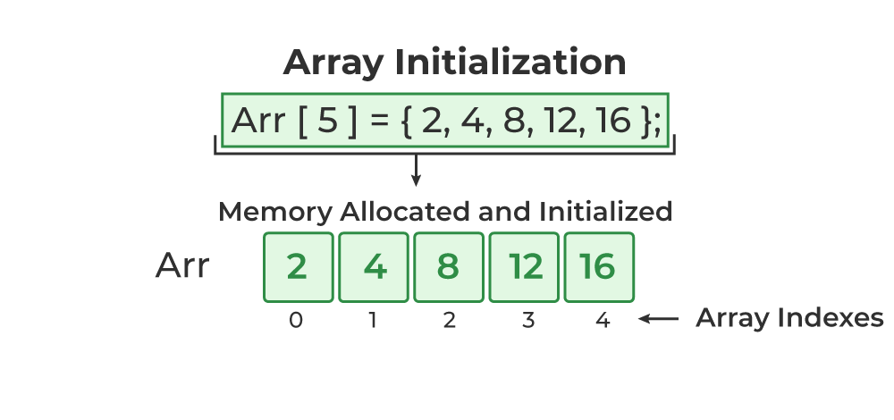
Array Initialization with Declaration
In this method, we initialize the array along with its declaration. We use an initializer list to initialize multiple elements of the array. An initializer list is the list of values enclosed within braces { } separated by a comma.
data_type array_name [size] = {value1, value2, ... valueN};

Slide 87
Array Initialization with Declaration without Size
If we initialize an array using an initializer list, we can skip declaring the size of the array as the compiler can automatically deduce the size of the array in these cases.
data_type array_name[] = {1,2,3,4,5};
The size of the above arrays is 5 which is automatically deduced by the compiler.
#include <stdio.h>
int main() {
// Declare and initialize an array without specifying its size
int arr[] = {10, 20, 30, 40, 50};
// The size of the array is automatically determined to be 5
int n = sizeof(arr) / sizeof(arr[0]); // Calculate the size of the array
// Print the array elements
printf("Array elements: ");
for(int i = 0; i < n; i++) {
printf("%d ", arr[i]);
}
return 0;
}
Output:
Array elements: 10 20 30 40 50

Slide 88
Array Initialization after Declaration (Using Loops)
#include <stdio.h>
int main() {
int arr[5]; // Declare an array of size 5
int i;
// Initialize array elements using a for loop
for(i = 0; i < 5; i++) {
arr[i] = i + 1; // Assign values 1, 2, 3, 4, 5 to the array elements
}
// Print the array elements
printf("Array elements: ");
for(i = 0; i < 5; i++) {
printf("%d ", arr[i]);
}
return 0;
}
Output:
1 2 3 4 5

Slide 89
#include <stdio.h>
int main() {
int arr[5]; // Declare an array of size 5
int i;
// Get user input to initialize the array
printf("Enter 5 integers:\n");
for(i = 0; i < 5; i++) {
printf("Enter element %d: ", i + 1);
scanf("%d", &arr[i]); // Store user input in the array
}
// Print the array elements
printf("Array elements: ");
for(i = 0; i < 5; i++) {
printf("%d ", arr[i]);
}
return 0;
}

Slide 90
#include <stdio.h>
int main() {
int arr[5]; // Declare an array of size 5
int i;
// Initialize array elements using a pattern (e.g., square of index)
for(i = 0; i < 5; i++) {
arr[i] = (i + 1) * (i + 1); // Store the square of (i + 1)
}
// Print the array elements
printf("Array elements: ");
for(i = 0; i < 5; i++) {
printf("%d ", arr[i]);
}
return 0;
}
Output
1 4 9 16 25

Slide 91
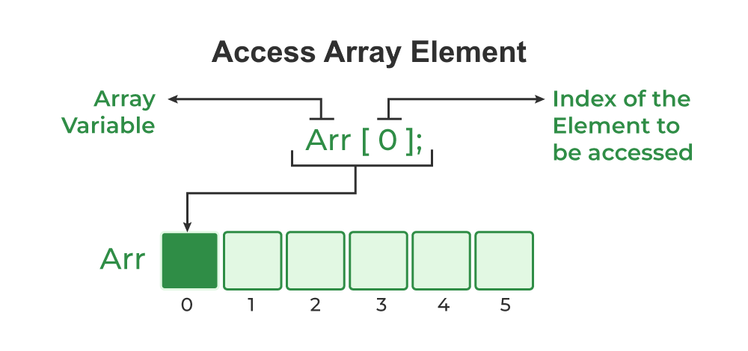
Access Array Elements
array_name [index];
One thing to note is that the indexing in the array always starts with 0, i.e., the first element is at index 0 and the last element is at N – 1 where N is the number of elements in the array.

Slide 92
// C Program to illustrate element access using array
// subscript
#include <stdio.h>
int main()
{
// array declaration and initialization
int arr[5] = { 15, 25, 35, 45, 55 };
// accessing element at index 2 i.e 3rd element
printf("Element at arr[2]: %d\n", arr[2]);
// accessing element at index 4 i.e last element
printf("Element at arr[4]: %d\n", arr[4]);
// accessing element at index 0 i.e first element
printf("Element at arr[0]: %d", arr[0]);
return 0;
}

Slide 93
Update Array Element
#include <stdio.h>
int main() {
int arr[5] = {10, 20, 30, 40, 50}; // Initialize an array with 5 elements
printf("Original array: ");
for(int i = 0; i < 5; i++) {
printf("%d ", arr[i]); // Print original array elements
}
// Update the 3rd element (index 2) of the array
arr[2] = 100;
printf("\nUpdated array: ");
for(int i = 0; i < 5; i++) {
printf("%d ", arr[i]); // Print updated array elements
}
return 0;
}
Syntax:
array_name[i] = new_value;
Output:
Original array: 10 20 30 40 50
Updated array: 10 20 100 40 50

Slide 94
Deleting an element from an array
#include <stdio.h>
int main() {
int arr[100] = {10, 20, 30, 40, 50}; // Array with some initial elements
int i, pos, size = 5; // Initial size of the array is 5
// Display the original array
printf("Original array: ");
for(i = 0; i < size; i++) {
printf("%d ", arr[i]);
}
printf("\n");
// Ask the user for the position of the element to be deleted
printf("Enter the position of the element to delete (1 to %d): ", size);
scanf("%d", &pos);

Slide 95
// Check if the position is valid
if(pos < 1 || pos > size) {
printf("Invalid position! Please enter a position between 1 and %d.\n", size);
} else {
// Deleting the element by shifting elements to the left
for(i = pos - 1; i < size - 1; i++) {
arr[i] = arr[i + 1];
}
// Decrease the size of the array by 1
size--;
// Display the array after deletion
printf("Array after deletion: ");
for(i = 0; i < size; i++) {
printf("%d ", arr[i]);
}
printf("\n");
}
return 0;
}
Output:
Original array: 10 20 30 40 50
Enter the position of the element to delete (1 to 5): 3 Array after deletion: 10 20 40 50

Slide 96
C Array Traversal
#include <stdio.h>
int main() {
int arr[5] = {10, 20, 30, 40, 50}; // Initialize an array with 5 elements
int i, sum = 0;
// Traversing the array, printing each element, and calculating the sum
printf("Array elements: ");
for(i = 0; i < 5; i++) {
printf("%d ", arr[i]); // Print each element
sum += arr[i]; // Add the element to the sum
}
// Print the total sum of the array elements
printf("\nSum of array elements: %d", sum);
return 0;
}
Output:
Array elements: 10 20 30 40 50
Sum of array elements: 150

Slide 97
Types of Array in C
There are two types of arrays based on the number of dimensions it has. They are as follows:
One Dimensional Arrays (1D Array)
Multidimensional Arrays

Slide 98
One Dimensional Arrays (1D Array)
// C Program to illustrate strings
#include <stdio.h>
int main()
{
// creating array of character
char arr[6] = { ‘a', 'e', ‘i', ‘o', ‘w', '\0' };
// printing string
int i = 0;
while (arr[i]) {
printf("%c", arr[i++]);
}
return 0;
}
Output:
aeiow

Slide 99
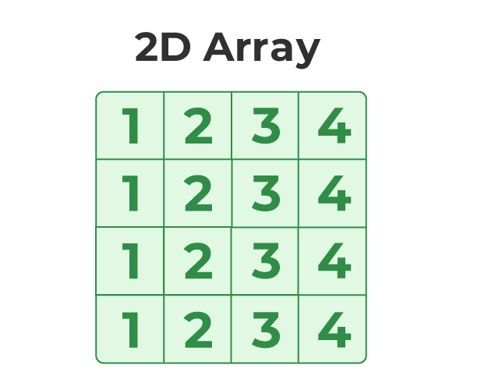
Multidimensional Array
Two-Dimensional Array
A Two-Dimensional array or 2D array in C is an array that has exactly two dimensions. They can be visualized in the form of rows and columns organized in a two-dimensional plane.
array_name[size1] [size2];
size1: Size of the first dimension.
size2: Size of the second dimension.

Slide 100
// C Program to illustrate 2d array
#include <stdio.h>
int main()
{
// declaring and initializing 2d array
int arr[2][3] = { 10, 20, 30, 40, 50, 60 };
printf("2D Array:\n");
// printing 2d array
for (int i = 0; i < 2; i++) {
for (int j = 0; j < 3; j++) {
printf("%d ",arr[i][j]);
}
printf("\n");
}
return 0;
}
Output:
2D Array:
10 20 30
40 50 60

Slide 101
Linear Search
Linear search is one of the simplest searching algorithms. It checks each element of an array or list sequentially until the desired element is found or the list ends. It can be inefficient for large datasets because it potentially examines every element.
How Linear Search Works:
Start at the first element of the array.
Compare the target element with the current element.
If the current element matches the target, the search is successful, and you can return the index of that element.
If the current element does not match the target, move to the next element and repeat step 2.
If the entire array is traversed without finding the target element, the search is unsuccessful.

Slide 102
#include <stdio.h>
int main() {
int arr[] = {10, 25, 30, 45, 60}; // Array of elements
int n = 5; // Size of the array
int target, i;
int found = 0; // Flag to check if the target is found
// Ask the user for the target value to search for
printf("Enter the element to search: ");
scanf("%d", &target);
// Linear Search Algorithm
for(i = 0; i < n; i++) {
if(arr[i] == target) { // If the target is found
printf("Element %d found at index %d.\n", target, i);
found = 1;
break;
}
}
// If the element is not found in the array
if(!found) {
printf("Element %d not found in the array.\n", target);
}
return 0;
}
Enter the element to search: 30
Element 30 found at index 2.
Enter the element to search: 100
Element 100 not found in the array.

Slide 103
Binary Search
Binary search is a more efficient algorithm for finding an element in a sorted array. Unlike linear search, which checks every element, binary search divides the search interval in half each time, drastically reducing the number of comparisons needed to find the target value.
How Binary Search Works:
Start with two pointers, one at the beginning (low) and one at the end (high) of the sorted array.
Find the middle element of the array.
Compare the middle element with the target value:
If the middle element is equal to the target, the search is successful, and you return the index.
If the middle element is greater than the target, repeat the search on the left half of the array.
If the middle element is less than the target, repeat the search on the right half of the array.
Repeat the process until the target is found or the low pointer exceeds the high pointer, indicating that the target is not in the array.

Slide 104
Binary Search -Example
int A[] = {0, 1, 2, 3, 4, 5, 6, 7, 8, 9, 10};
and VAL = 9, the algorithm will proceed in the following manner.
BEG = 0, END = 10, MID = (0 + 10)/2 = 5
Now, VAL = 9 and A[MID] = A[5] = 5
A[5] is less than VAL, therefore, we will now search for the value in the later half of the array. So, we change the values of BEG and MID.
Now, BEG = MID + 1 = 6, END = 10, MID = (6 + 10)/2 =16/2 = 8
Now, VAL = 9 and A[MID] = A[8] = 8
A[8] is less than VAL, therefore, we will now search for the value in the later half of the array. So, again we change the values of BEG and MID.
Now, BEG = MID + 1 = 9, END = 10,MID = (9 + 10)/2 = 9
Now VAL = 9 and A[MID] = 9.
Now VAL = 9 and A[MID] = 9.

Slide 105
#include <stdio.h>
int binarySearch(int arr[], int size, int target) {
int low = 0, high = size - 1;
while (low <= high) {
int mid = (low + high) / 2;
if (arr[mid] == target) {
return mid; // Target found at index mid
} else if (arr[mid] < target) {
low = mid + 1; // Continue search in the right half
} else {
high = mid - 1; // Continue search in the left half
}
}
return -1; // Target not found
}
int main() {
int arr[] = {10, 20, 30, 40, 50, 60, 70, 80, 90}; // Sorted array
int size = sizeof(arr) / sizeof(arr[0]);
int target;
// Ask the user for the target value to search for
printf("Enter the element to search: ");
scanf("%d", &target);
// Perform binary search
int result = binarySearch(arr, size, target);
// Output the result
if (result != -1) {
printf("Element %d found at index %d.\n", target, result);
} else {
printf("Element %d not found in the array.\n", target);
}
return 0;
}
Enter the element to search: 50
Element 50 found at index 4.

Slide 106
Advantages:
Efficiency: Binary search is much faster than linear search for large datasets, especially when the array is large.
Simplicity: The algorithm is easy to understand and implement for sorted arrays.
Disadvantages:
Sorted Array Required: Binary search only works on arrays that are sorted.
Fixed Size: Binary search is generally applied to arrays with fixed size or that can be indexed efficiently.

Slide 107
SPARSE MATRIX
Sparse matrix is a matrix that has many elements with a value zero.
In order to efficiently utilize the memory, specialized algorithms and data structures that take advantage of the sparse structure of the matrix should be used. Otherwise, execution will slow down and the matrix will consume large amounts of memory.
There are two types of sparse matrices. In the first type of sparse matrix, all elements above the main diagonal have a value zero. This type of sparse matrix is also called a (lower) triagonal matrix. In a lower triangular matrix, Ai,j= 0 where i<j.
An nXnlower triangular matrix A has one non zero element in the first row, two non zero element in the second row and likewise, n non zero elements in the nth row.

Slide 108
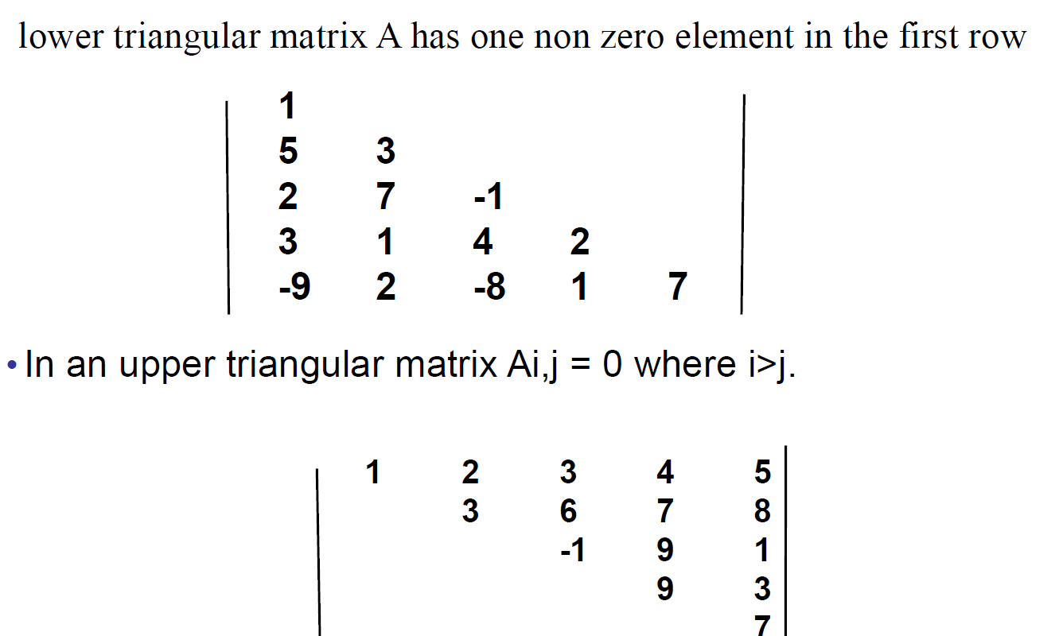

Slide 109
Functions
The syntax of function can be divided into 3 aspects:
Function Declaration
return_type name_of_the_function (parameter_1, parameter_2);
The parameter name is not mandatory while declaring functions. We can also declare the function without using the name of the data variables.
int sum(int a, int b); // Function declaration with parameter names
int sum(int , int); // Function declaration without parameter names

Slide 110
Function Definition
return_type function_name (para1_type para1_name, para2_type para2_name)
{
// body of the function
}
Function Calls
Function call is neccessary to bring the program control to the function definition. If not called, the function statements will not be executed.

Slide 111
// C program to show function
// call and definition
#include <stdio.h>
// Function that takes two parameters
// a and b as inputs and returns
// their sum
int sum(int a, int b)
{
return a + b;
}
// Driver code
int main()
{
// Calling sum function and
// storing its value in add variable
int add = sum(10, 30);
printf("Sum is: %d", add);
return 0;
}
Output:
Sum is: 40

Slide 112
Conditions of Return Types and Arguments
Functions can be called either with or without arguments and might return values. They may or might not return values to the calling functions.
int function_name(int var1, int var2);
Function with no arguments and no return value
Function with no arguments and with return value
Function with argument and with no return value
Function with arguments and with return value

Slide 113
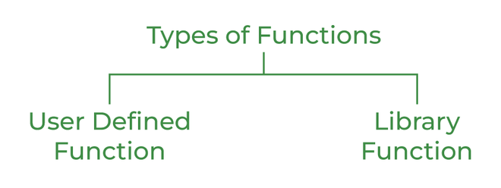
Types of Functions
There are two types of functions in C:
Library Functions
User Defined Functions

Slide 114
Library Function
#include <math.h>
#include <stdio.h>
int main()
{
double Number;
Number = 49;
// Computing the square root with
// the help of predefined C
// library function
double squareRoot = sqrt(Number);
printf("The Square root of %.2lf = %.2lf",
Number, squareRoot);
return 0;
}
is also referred to as a “built-in function”. A compiler package already exists that contains these functions.
pow(), sqrt(), strcmp(), strcpy() etc.
Output:
The Square root of 49.00 = 7.00

Slide 115
User Defined Function
#include <stdio.h>
int sum(int a, int b)
{
return a + b;
}
int main()
{
int a = 30, b = 40;
// function call
int res = sum(a, b);
printf("Sum is: %d", res);
return 0;
}
Output:
Sum is: 70

Slide 116
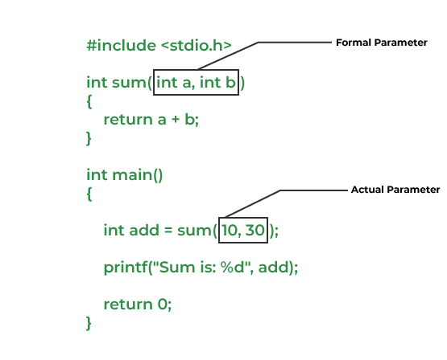
Passing Parameters to Functions
We can pass arguments to the C function in two ways:
Pass by Value
Pass by Reference

